Slide 1


Demographic Trends and Forecasts in Saudi Arabia
This comprehensive analysis examines the population trends and forecasts within Saudi Arabia, focusing on key urban centers and demographic shifts from 2010 to 2022. By exploring growth rates in major cities, projecting future demographic changes, and analyzing gender-specific population patterns, this report aims to provide valuable insights to policymakers, urban planners, and researchers. The findings will facilitate informed decision-making to support sustainable urban development and demographic management in the rapidly evolving socio-economic landscape of the country.

Slide 2

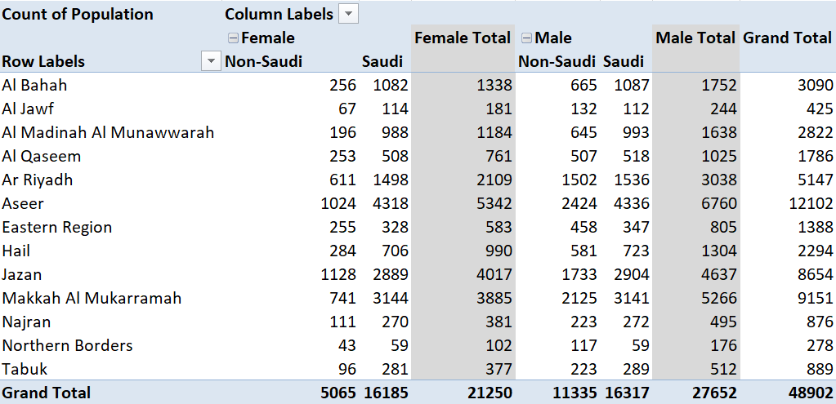
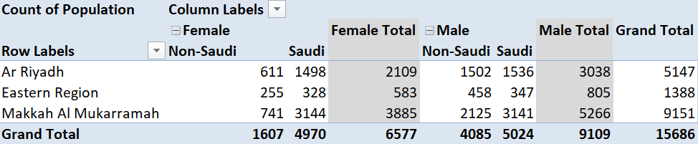
Data Cleaning and Reduction
To streamline our analysis and ensure a focused approach, we have chosen to concentrate on three major regions: Ar Riyadh, Makkah Al Mukarramah, and the Eastern Region. These areas are among the most economically significant and densely populated in Saudi Arabia, making them particularly relevant for understanding national trends. By excluding data pertaining to other cities, we were able to eliminate noise from less impactful regions and concentrate our resources on analyzing trends that are most indicative of broader demographic changes in the country. This data reduction process not only simplifies the handling and analysis but also enhances the accuracy and relevance of our findings to the targeted regions.

Slide 3

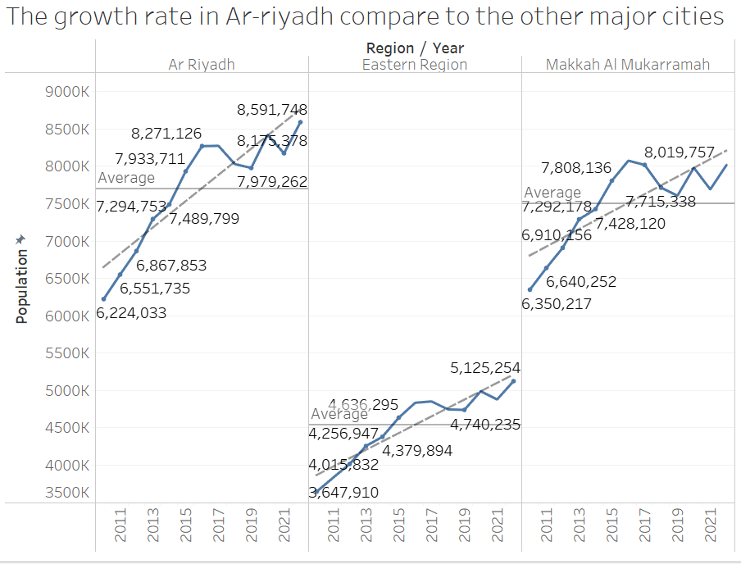
Growth Rate Comparison
2017-2018 Decline
Further Analysis
Based on our analysis, we observed a decline in the data from 2017 to 2018, followed by a stabilization through 2019. In 2020, there was an uptick. We aim to investigate the factors contributing to the drop in 2018, which was most pronounced among non-Saudi residents in the major cities.
To pinpoint the exact causes, further analysis with contextual data from that period would be needed. The specific reasons behind these population trends are likely tied to a complex interplay of economic policies and shifts in the regulatory landscape affecting non-Saudis living in Saudi Arabia.
1
2
3
Possible Reasons
The decline in non-Saudi residents could be attributed to a combination of economic factors, policy changes, and shifts in social conditions. Economic slowdowns, job market changes, or adjustments in immigration and labor laws may have discouraged expatriate residents from staying or new ones from arriving. Changes in social benefits, healthcare, or education policies affecting non-Saudis could also have influenced their decision to reside in these regions.

Slide 4
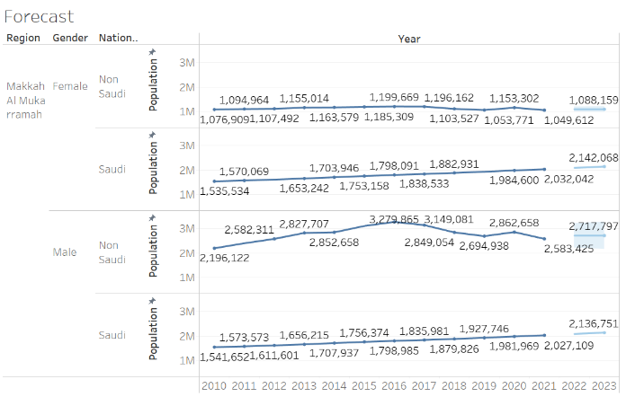
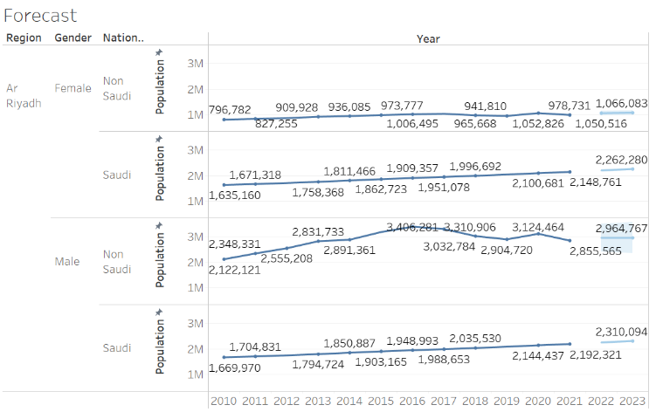
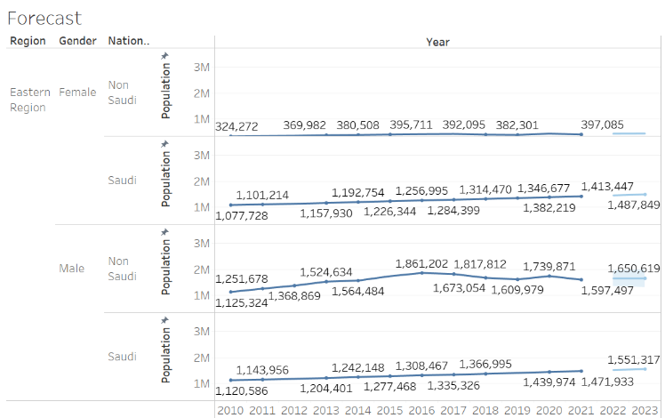
Population Forecast for Major Cities
1- Makkah Al Mukarramah
2-Ar Riyadh
3-Eastern Region
The population forecast suggests a general trend of increase for both Saudi and non-Saudi populations across all genders. Notably, the non-Saudi female population is expected to stabilize after a slight decrease, while the Saudi female population shows a steady increase. This suggests a strengthening of demographic stability and possibly improved living conditions or job opportunities in the region which may attract more residents.
In Ar Riyadh, the forecast indicates a consistent growth in population among Saudi males and females, suggesting ongoing urban development and economic opportunities that continue to attract Saudis to the capital. The non-Saudi population, particularly males, shows a more fluctuating trend but remains relatively stable, indicating that while there may be changes in expatriate workforce policies, the overall expatriate community remains integral to the region's demographic composition.
The Eastern Region shows a steady increase in both Saudi and non-Saudi populations across all demographics. The consistent growth pattern across all groups suggests that the region remains a key area for both economic activity and residential attractiveness, likely driven by the oil and petrochemical industries which are significant employers in the area.

Slide 5
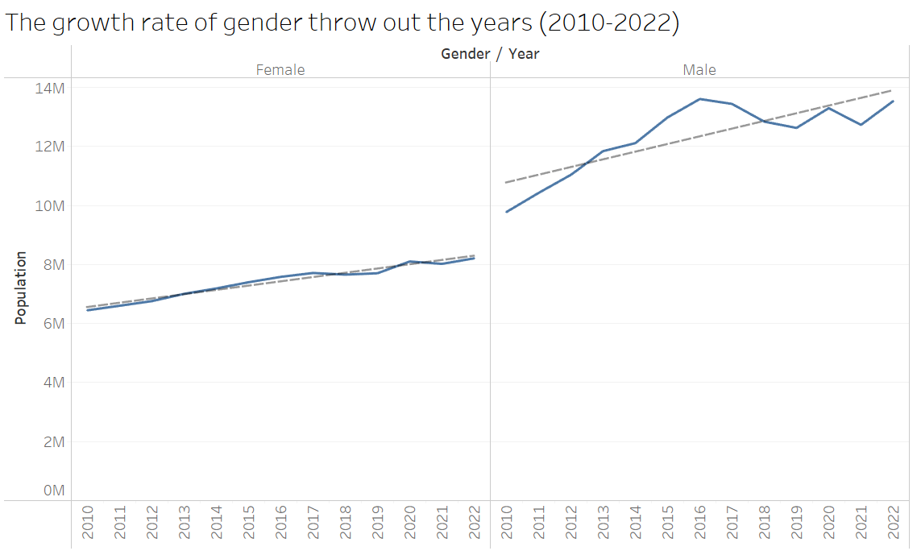
Gender-Specific Growth Rate Analysis (2010-2022)
Male Population Growth
Female Population Growth
The trend line for male population growth shows an upward trajectory, but the fluctuation in growth rate is more pronounced than for females. The regression formula suggests that the male population can be predicted by the year, with an R-squared value of 0.674, indicating that 67.4% of the variance in male population growth can be explained by the year. The low p-value of 0.0005779 confirms the statistical significance of this relationship.
The female population growth curve is steadier and shows a more consistent upward trend compared to males. The regression formula has a higher R-squared value of 0.962, suggesting that 96.2% of the variability in female population growth is predictable from the year. The extremely low p-value of less than 0.0001 reinforces the reliability of the model, indicating that the year is a highly significant predictor of female population growth.

Slide 6

Conclusion
1
Key Insights
2
Implications for Decision-Making
This comprehensive analysis of demographic trends and forecasts in Saudi Arabia provides valuable insights for policymakers, urban planners, and researchers. The findings highlight the importance of considering gender-specific factors, the influence of economic and policy changes on population dynamics, and the need for targeted strategies to address the unique demographic challenges faced by major urban centers.
The data-driven insights generated through this project can inform evidence-based decision-making, enabling stakeholders to develop policies, allocate resources, and plan infrastructure that cater to the evolving demographic landscape. By understanding the nuanced patterns of population growth, urban planners can better anticipate and address the changing needs of communities, ultimately contributing to the sustainable development of Saudi Arabia's cities.
3
Future Research Directions
This study lays the groundwork for further exploration of demographic trends in Saudi Arabia. Potential areas for future research include investigating the socio-economic factors driving population changes, analyzing the impact of urbanization on different demographic groups, and exploring the interplay between population dynamics and the country's economic diversification efforts.

